Slide 1
Preliminary study on the consistency among hydrological angular momentum estimates determined from CMIP6 historical simulations
Jolanta Nastula¹, Tomasz Kur¹, Justyna Śliwińska¹, Małgorzata Wińska², Aleksander Partyka¹
¹Centrum Badań Kosmicznych Polskiej Akademii Nauk, Warsaw, Poland
²Warsaw University of Technology, Faculty of Civil Engineering, Warsaw, Poland
XXXI General Assembly of International Astronomical Union, 2-11 August 2022, Busan, Republic of Korea

Slide 2
Introduction
The excitation of polar motion (PM) resulting from changes in mass redistribution of hydrosphere can be expressed with hydrological angular momentum (HAM) series, which can be estimated from: global models of continental hydrosphere, Earth’s gravity field variations, numerical climate models.
The aim of this study is to determine hydrological excitation of PM (hydrological angular momentum, HAM) from various climate models collected and made available under the Coupled Model Intercomparison Project Phase 6 (CMIP6) and to validate CMIP6-based HAM estimates using precise geodetic measurements of the pole coordinates (geodetic residuals, GAO).
Our preliminary analyses have shown that selection of the best CMIP6 model for the study of HAM depends on several factors such as considered oscillation, analysed equatorial component of HAM or the assumed criterion of validation (Nastula et al. 2022).
Overall, the correspondence between GAO and HAM received from CMIP6 is generally lower than the previously obtained consistency between GAO and HAM determined from Gravity Recovery and Climate Experiment (GRACE) data.
However, it may be possible to find one or a few CMIP6 models from among almost several hundred available that provides HAM series more compatible with GAO than HAM from GRACE or LSDM, especially in annual oscillations.
Nastula, J., Śliwińska, J., Kur, T., Wińska, M., Partyka, A. (2022). Preliminary study on hydrological angular momentum determined from CMIP6 historical simulations. Earth, Planets and Space, 74, 1–26. https://doi.org/10.1186/s40623-022-01636-z

Slide 3
Introduction
The aims of this study are now:
to analyse the consistency among CMIP6-based HAM series with respect to the mean of all considered models,
to group the CMIP6-based HAM series taking into account the institutes that developed the models and to determine the mean HAM in these groups,
to compare CMIP6-based HAM estimates with:
hydrological signal in observed excitation – geodetic residuals (GAO = geodetic angular momentum minus atmospheric angular momentum minus oceanic angular momentum, GAO = GAM–AAM–OAM);
HAM determined from Gravity Recovery and Climate Experiment (GRACE) Level-3 data;
HAM determined from Land Surface Discharge Model (LSDM).

Slide 4
HAM computation
To compute equatorial components (χ₁, χ₂) of HAM based on terrestrial water storage (TWS), we use the following formulas (Eubanks 1993):
$$χ_{1}=−\frac{{1.0966R}_{e}^{2}}{C−A}\iint{TWS\left(φ,λ,t\right)\sin{φ}\cos{φ}\cos{λdS}}$$
$$χ_{2}=−\frac{{1.0966R}_{e}^{2}}{C−A}\iint{TWS\left(φ,λ,t\right)\sin{φ}\cos{φ}\sin{λdS}}$$
where R_{e} is Earth’s mean radius, dS is the surface area and C and A are Earth’s principal moments of inertia. The factor 1.0966 accounts for the yielding of the solid Earth to surface load, rotational deformation and core-mantle decoupling.
TWS from CMIP6 models is calculated using the following formula:
$TWS=Soil Water Storage+Snow Water Storage$,
where for Soil Water Storage, we used „mrso” variable; for Snow Water Storage, we used „snw” variable from CMIP6.
TWS from GRACE is taken from Level-3 data (CSR RL06 solution).
Additionally, we use χ₁, χ₂ components of HAM computed from LSDM model provided by GFZ.
Eubanks, T.M. (1993). Variations in the orientation of the earth. In: Smith, D.E., Turcotte, D.L. (Eds.), Contributions of Space Geodesy to Geodynamics: Earth Dynamics, Vol. 24 Geodynamics Series. AGU, Washington, pp. 1–54

Slide 5
CMIP6 data selection
In our study, we use CMIP6 historical simulations.
Depending on the CMIP6 model, a single variable is given either in one file or in several separate files that have different time intervals. For the purpose of this study, the variables given in a few separate files were merged into one.
Models that showed visible jumps after the merger were excluded from further processing.
We decided to limit the period of our preliminary comparisons to the period of GRACE data availability (2003–2014). Therefore, we also excluded CMIP6 models that ended before 2013.
Such a selection made it possible to distinguish 99 historical models out of several hundreds.
These models were further analysed and evaluated separately for trends, seasonal and non-seasonal variations.

Slide 6
GAO computation
GAO can be computed as a difference between geodetic angular momentum (GAM) and a sum of atmospheric angular momentum (AAM) and oceanic angular momentum (OAM):
$$GAO=GAM−AAM−OAM$$
Here, we use GAO computed by International Earth Rotation and Reference Systems Service (IERS) Earth Orientation Centre (http://hpiers.obspm.fr/eop-pc/) and based on the following datasets:
χ₁ and χ₂ components of GAM – based on time series of Earth Orientation Parameters EOP 14 C04 solution,
χ₁ and χ₂ components of AAM (mass + motion terms) based on ECMWF (European Center for Medium–Range Weather Forecasts) model and provided by GeoForschungsZentrum (GFZ),
χ₁ and χ₂ components of OAM (mass + motion terms) based on MPIOM (Max Planck Institute Ocean Model) model and provided by GFZ.

Slide 7
Spread of CMIP6-based HAM
The consistency among CMIP6-based HAM were analysed in the form of:
time series comparisons
statistical values

Slide 8
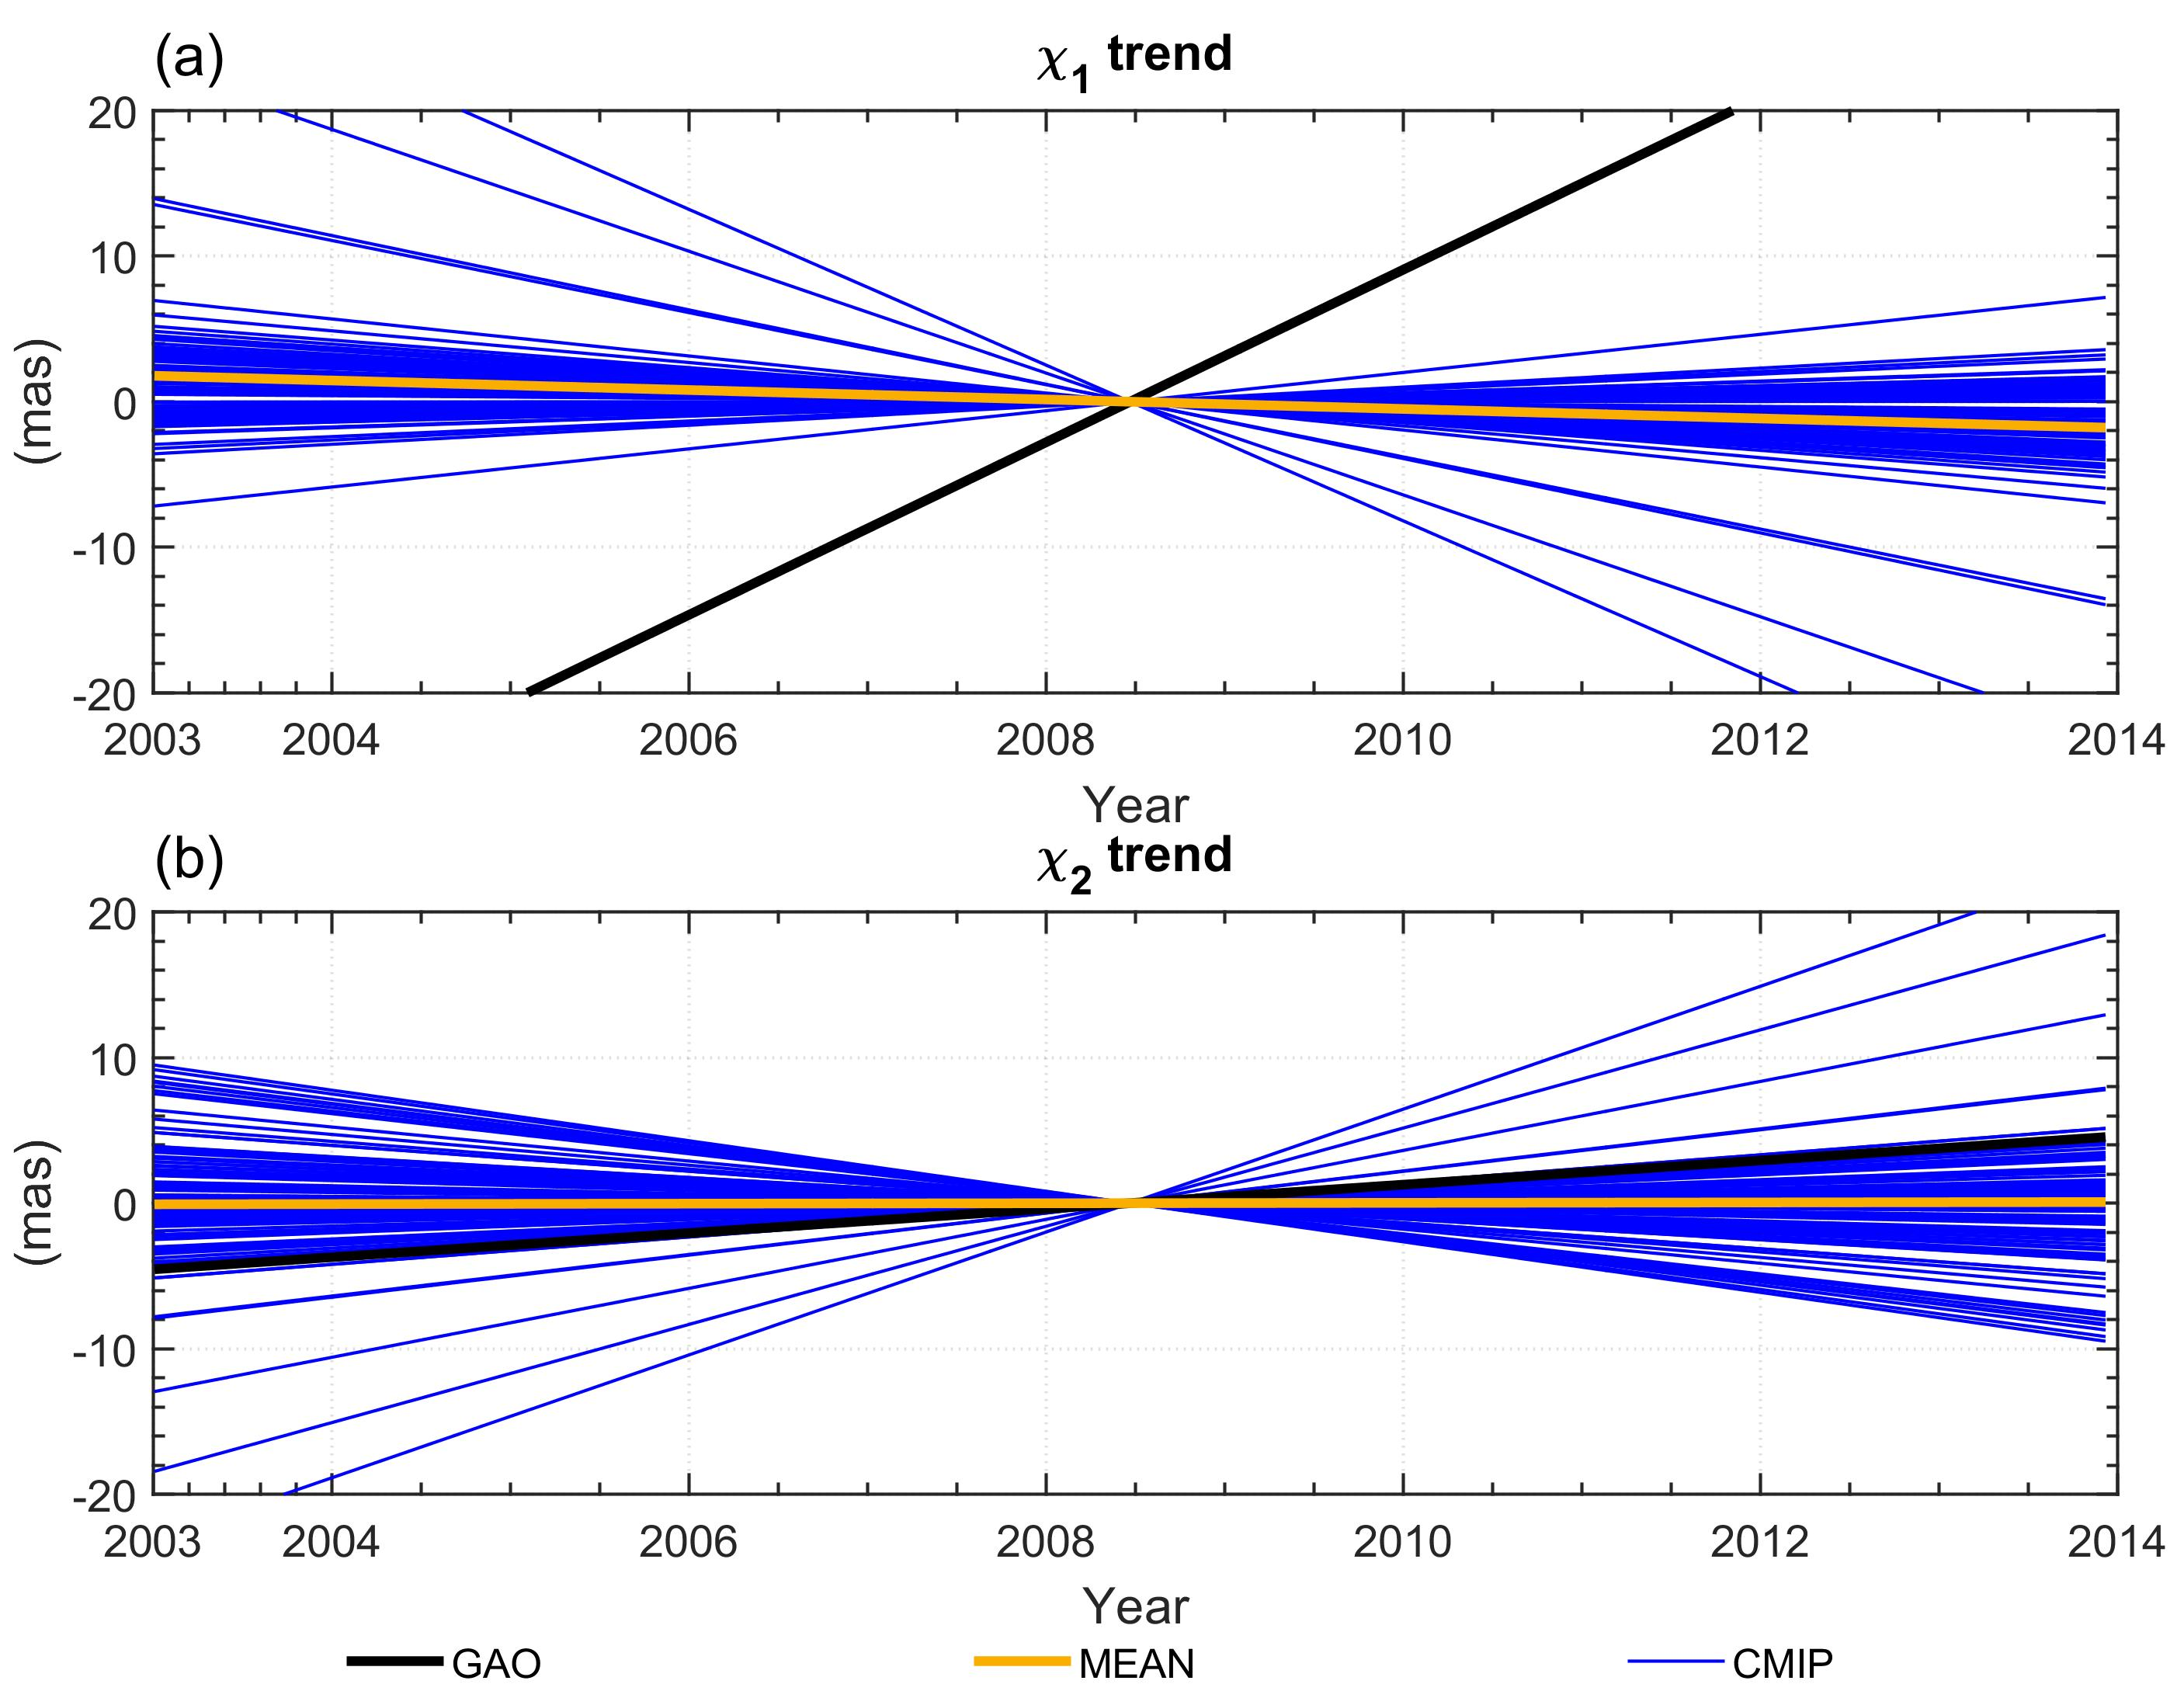
Spread of CMIP6-based HAM – Trend
Table 1. Trend values in χ₁ and χ₂ components of GAO and HAM computed from CMIP6 models and MEAN model
 | Trend parameters
 | CMIP |  |  |  | GAO
 | Min | Median | Max | MEAN
$χ_{1}$ (mas/year) | -5.35 | -0.23 | 1.31 | -0.33 | 5.93
$χ_{2}$ (mas/year) | -1.74 | 0.00 | 4.22 | 0.01 | 0.83
Trend values for MEAN in χ₁ and χ₂ are almost identical. CMIP6 based trends better suit to GAO in χ₂ than in χ₁
Fig. 1. Trends in χ₁ and χ₂ components of GAO and HAM computed from CMIP6 models and MEAN model

Slide 9
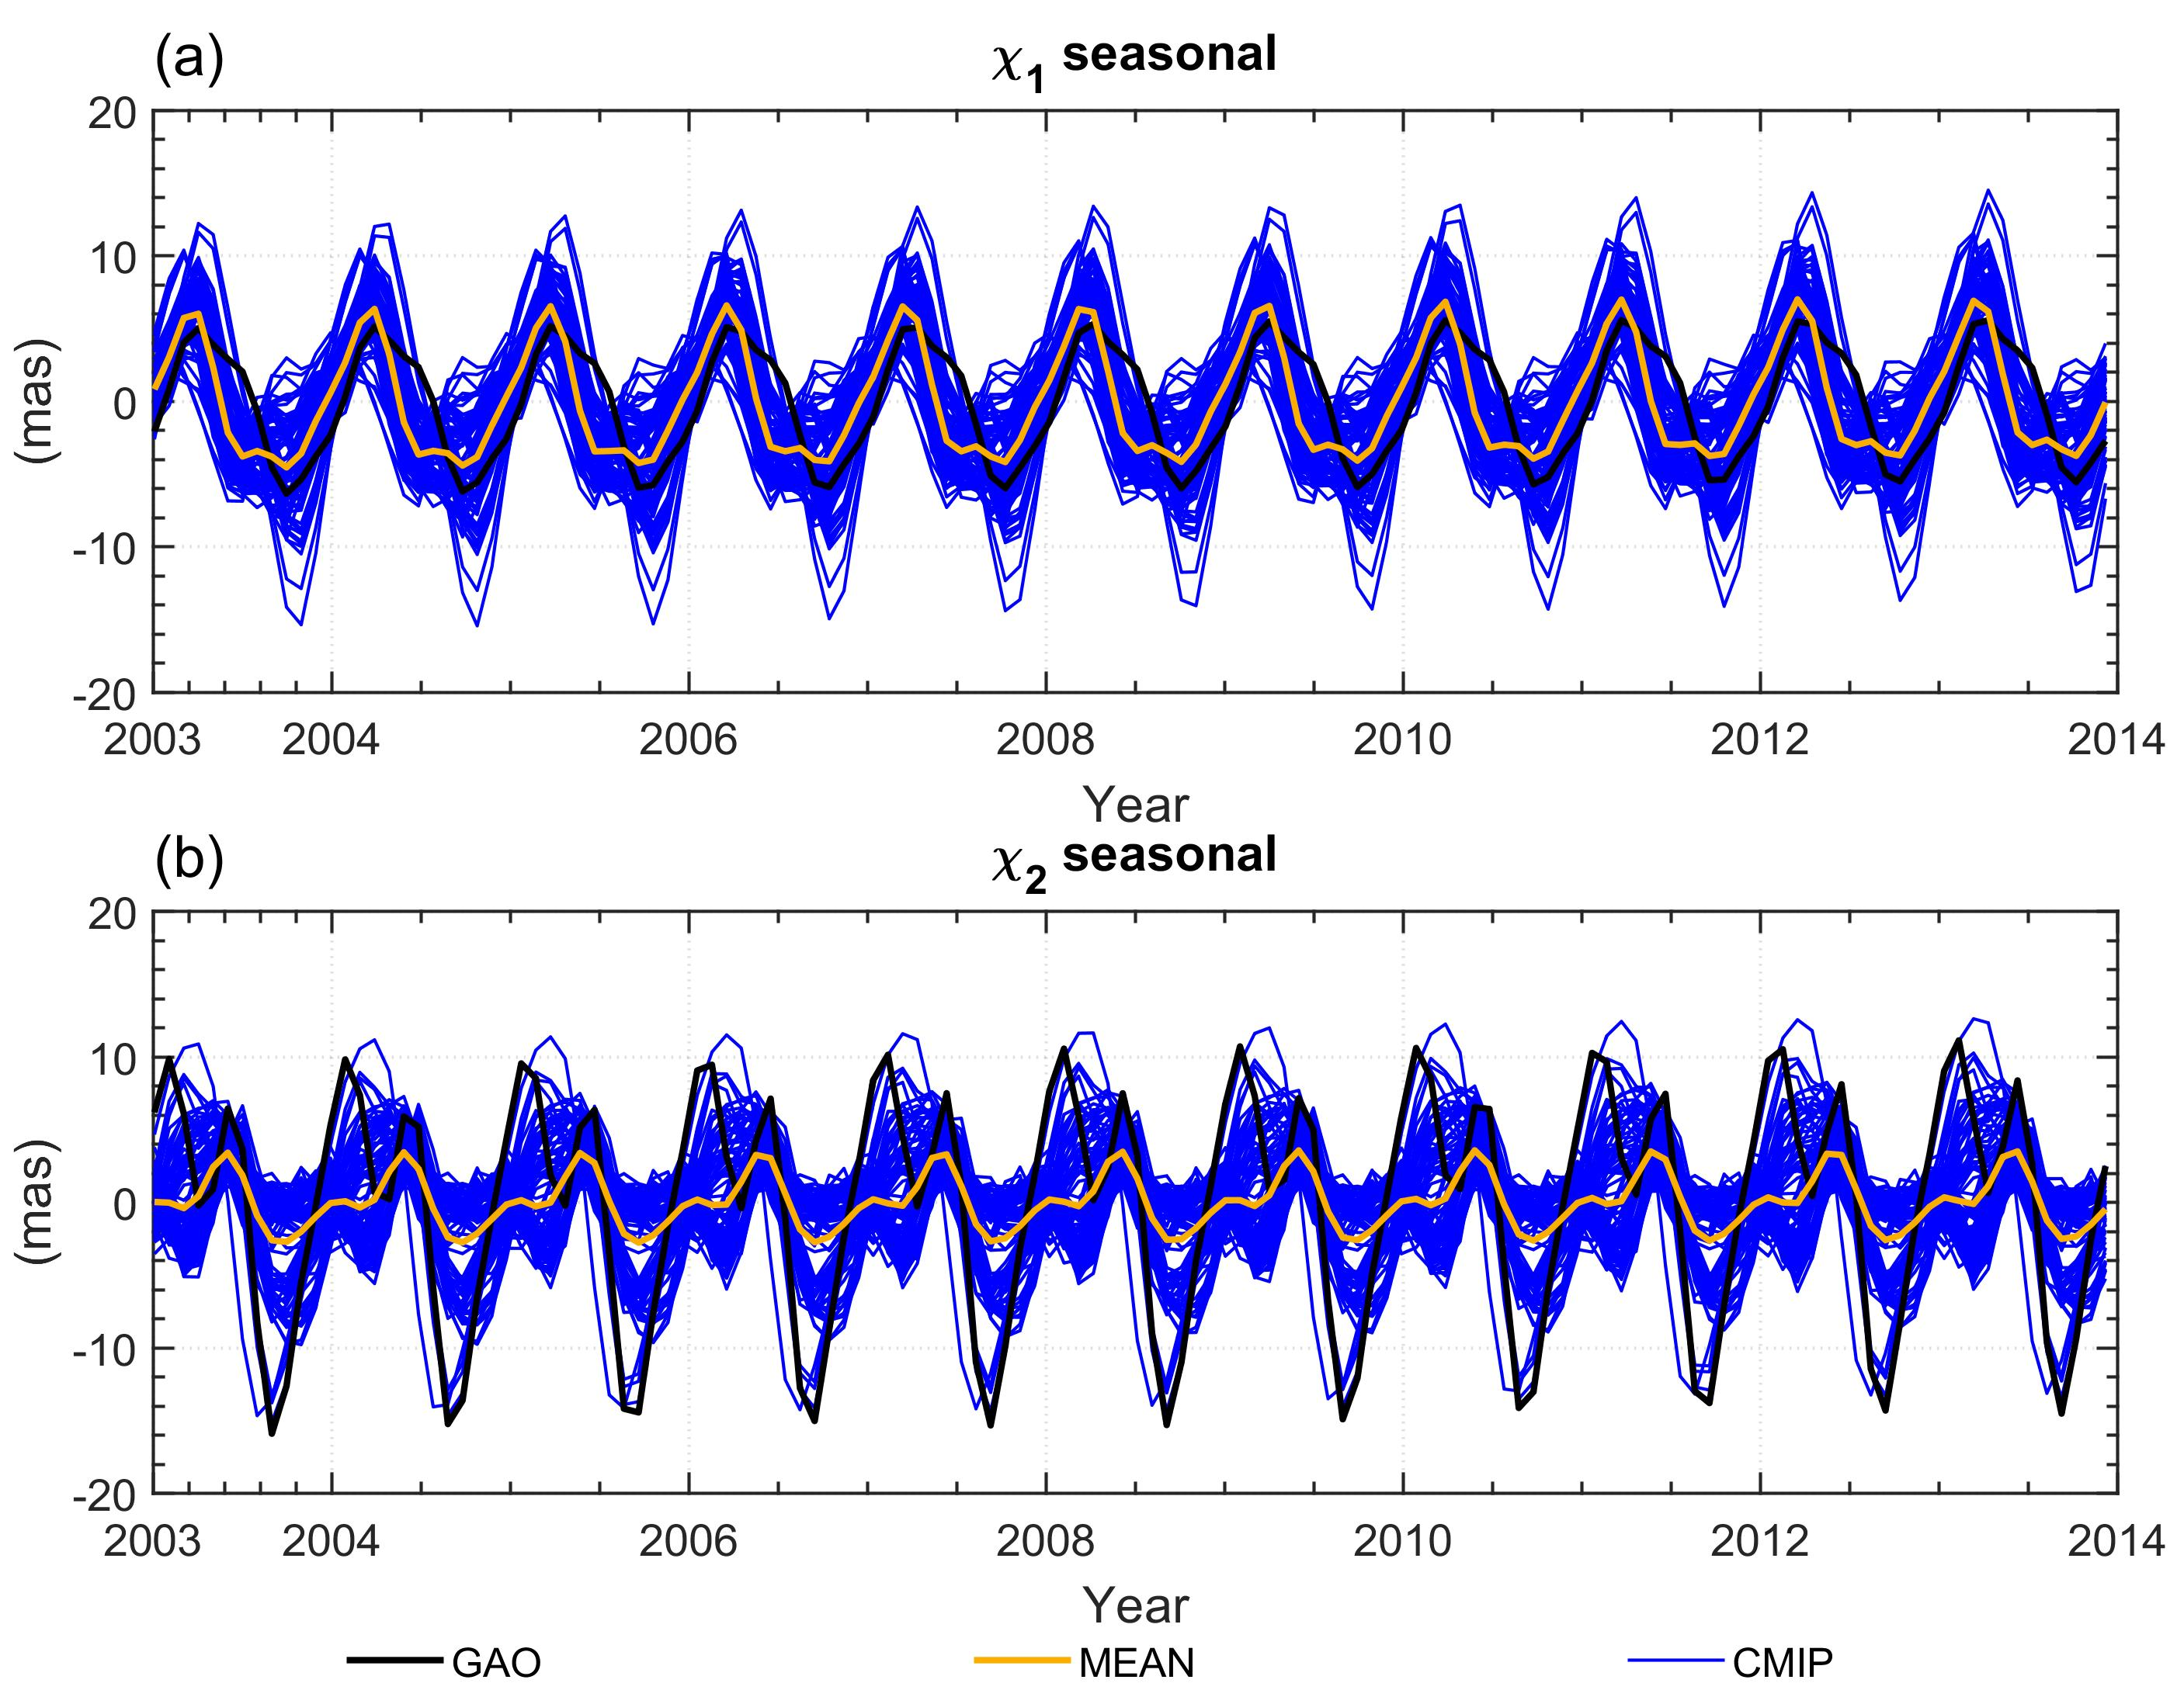
Spread of CMIP6-based HAM – Seasonal
Table 2. Statistics of χ₁ and χ₂ components of seasonal oscillations in GAO and HAM computed from CMIP6 models and MEAN model
 |  | Seasonal
 |  | Min | Median | Max
CMIP | $χ_{1}$ (mas) | -15.42 | -0.47 | 14.52
 | $χ_{2}$ (mas) | -15.10 | 0.14 | 12.63
GAO | $χ_{1}$ (mas) | -6.33 | 0.20 | 5.59
 | $χ_{2}$ (mas) | -15.90 | 1.35 | 11.14
MEAN | $χ_{1}$ (mas) | -4.53 | -1.33 | 7.02
 | $χ_{2}$(mas) | -2.76 | -0.08 | 3.58
In χ₁ GAO is between the range for CMIP6 models, while for χ₂ GAO usually exceeds min and max values for CMIP6
Fig. 2. χ₁ and χ₂ components of seasonal oscillations in GAO and HAM computed from CMIP6 models and MEAN model

Slide 10
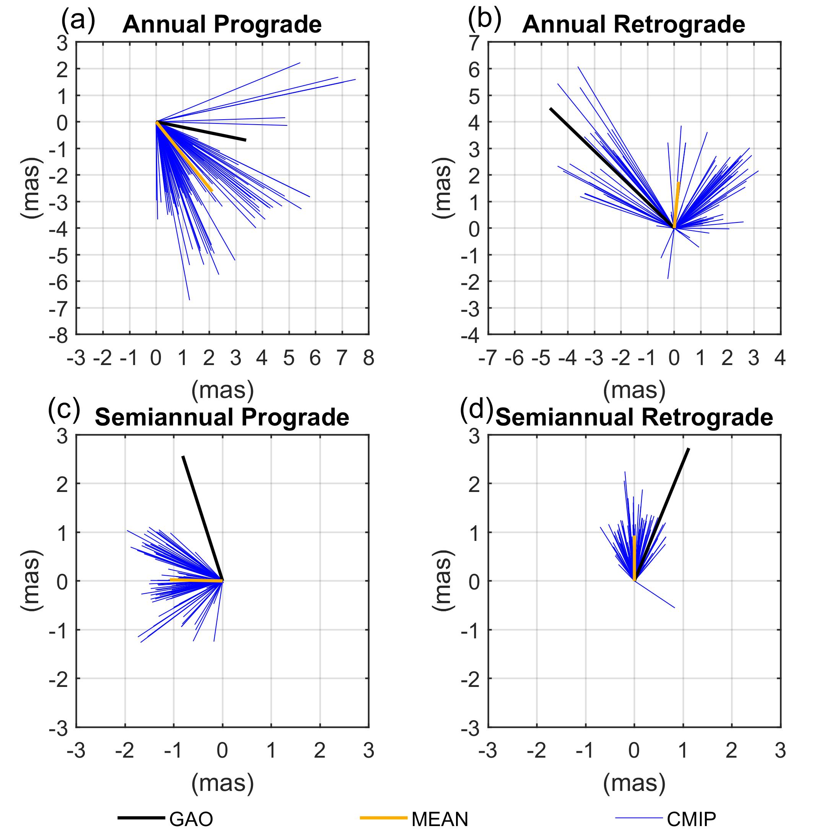
Spread of CMIP6-based HAM – Oscillations
Table 3. Statistics of oscillations in GAO and HAM computed from CMIP6 models and MEAN model
 |  | CMIP |  |  | GAO | MEAN
 |  | Min | Median | Max
Annual Prograde | Phase (°) | -32.84 | 0.00 | 0.00 | -11.56 | -51.18
 | Amplitude (mas) | 1.38 | 3.30 | 7.67 | 3.46 | 3.37
Annual Retrograde | Phase (°) | 0.00 | 0.00 | 100.90 | 136.03 | 84.57
 | Amplitude (mas) | 0.29 | 3.01 | 7.08 | 6.50 | 1.75
Semiannual Prograde | Phase (°) | -151.99 | 0.00 | 0.00 | 107.69 | 178.80
 | Amplitude (mas) | 0.05 | 1.27 | 2.22 | 2.69 | 1.08
Semiannual Prograde | Phase (°) | 0,00 | 0.00 | 106.45 | 67.72 | 89.98
 | Amplitude (mas) | 0.02 | 0.98 | 2.25 | 2.94 | 0.93
The best agreement for MEAN with GAO in amplitude is seen in annual prograde, when the best agreement in phase can be seen in semiannual retrograde.
Fig. 3. Phasor diagrams of annual prograde, annual retrograde, semiannual prograde, and semiannual retrograde oscillation in GAO and HAM computed from CMIP6 models and MEAN model

Slide 11
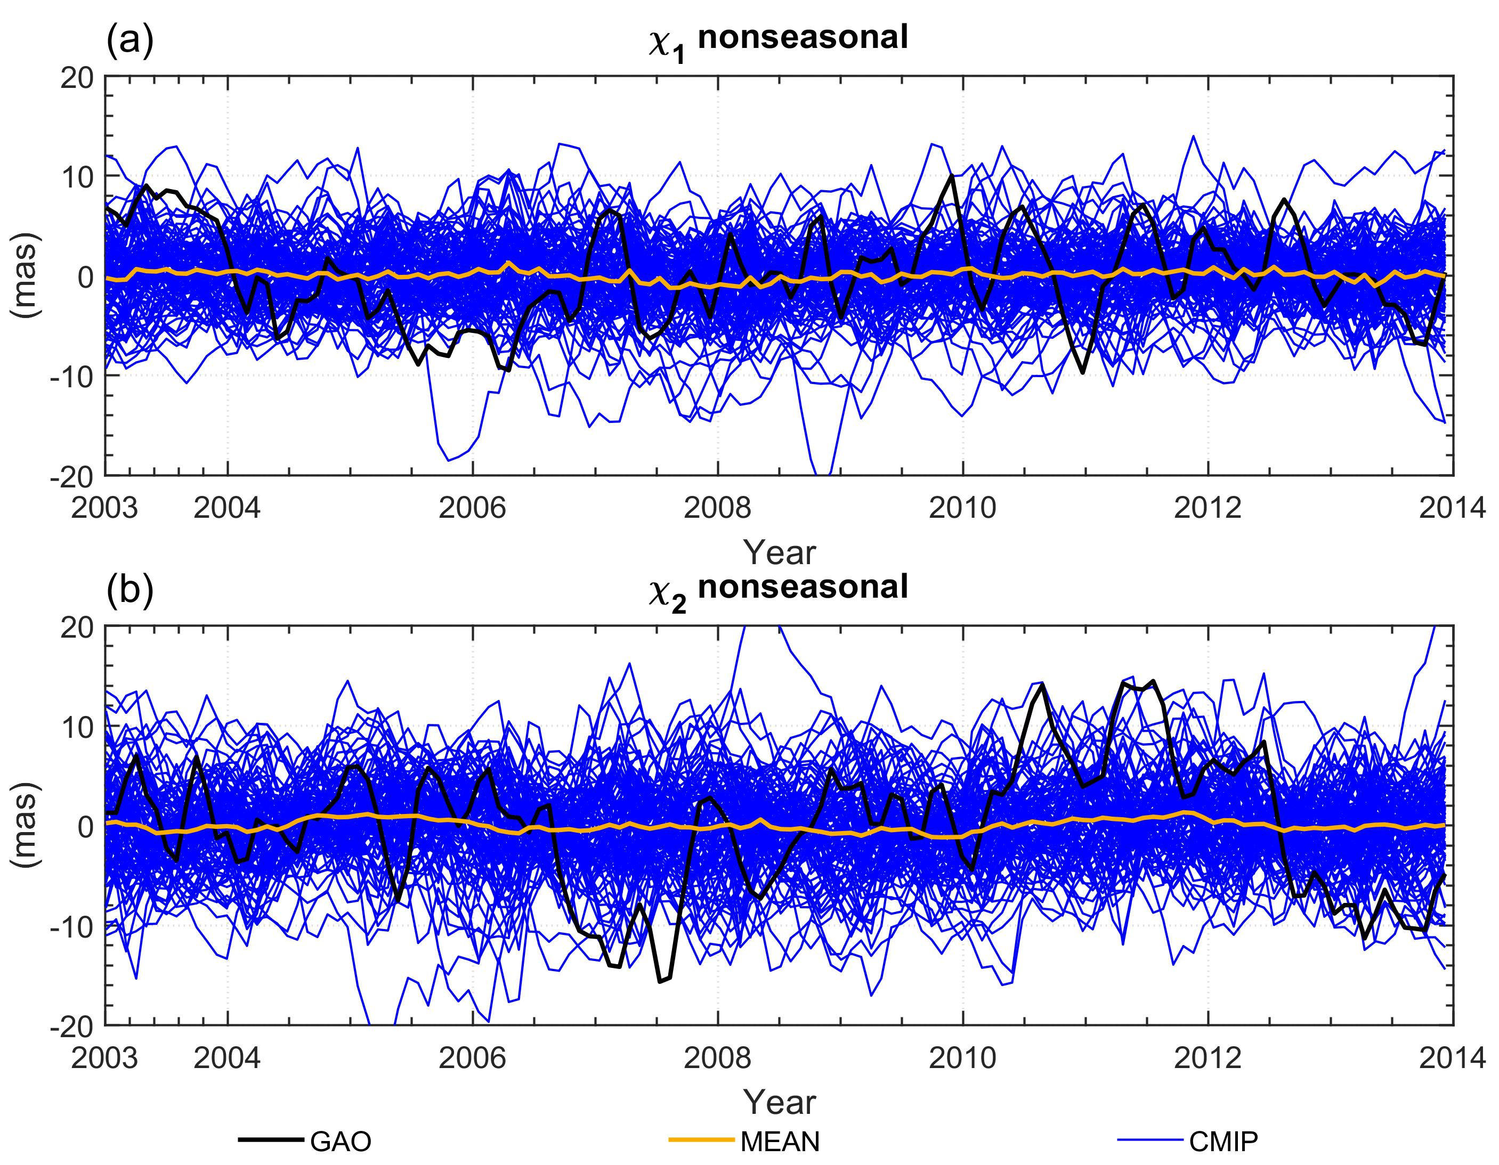
Spread of CMIP6-based HAM – Nonseasonal
Table 4. Statistics of χ₁ and χ₂ components of nonseasonal oscillations in GAO and HAM computed from CMIP6 models and MEAN model
Nonseasonal
 |  | Min | Median | Max
CMIP | $χ_{1}$ (mas) | -21.37 | 0.15 | 13.97
 | $χ_{2}$ (mas) | -23.09 | 0.04 | 23.56
GAO | $χ_{1}$ (mas) | -9.72 | -0.24 | 10.01
 | $χ_{2}$ (mas) | -15.64 | 0.88 | 14.46
MEAN | $χ_{1}$ (mas) | -1.23 | 0.09 | 1.30
 | $χ_{2}$ (mas) | -1.19 | -0.08 | 1.32
Mean from all CMIP6 models oscillates around 0.
Using mean of CMIP6 models to compare with GAO is not recommended.
Fig. 4. χ₁ and χ₂ components of nonseasonal oscillations in GAO and HAM computed from CMIP6 models and MEAN model

Slide 12
Grouped models analysis
CMIP6-based HAM series were grouped taking into account the institutes that developed the models.
Then the mean HAM was computed for each groups.
Table 5. Models taken for analysis. ALL means mean from all models and is the same as MEAN from previous figures and tables
Model provider | Model count | Standard deviation in group
 |  | $χ_{1}$ (mas) | $χ_{2}$ (mas)
ALL | 99 | 6.24 | 6.16
ACCESS | 5 | 11.23 | 11.58
BCC | 6 | 3.28 | 3.40
CanESM5 | 5 | 6.96 | 6.42
GFDL | 1 | 6.04 | 11.48
GISS | 52 | 5.06 | 4.44
MIROC | 12 | 7.97 | 9.17
MPI | 12 | 7.22 | 6.27
MRI | 6 | 5.35 | 5.35

Slide 13
Grouped models analysis
To select the most appropriate group of models for HAM determination in particular spectral band, we looked for a CMIP6 model that meet the certain criteria.
For annual oscillation
with the smallest difference between GAO and CMIP6-based HAM in either the phase or the amplitude of annual oscillation
For nonseasonal
with the smallest difference in variance
the highest correlation for the nonseasonal series
For trend
with the smallest difference in trends

Slide 14
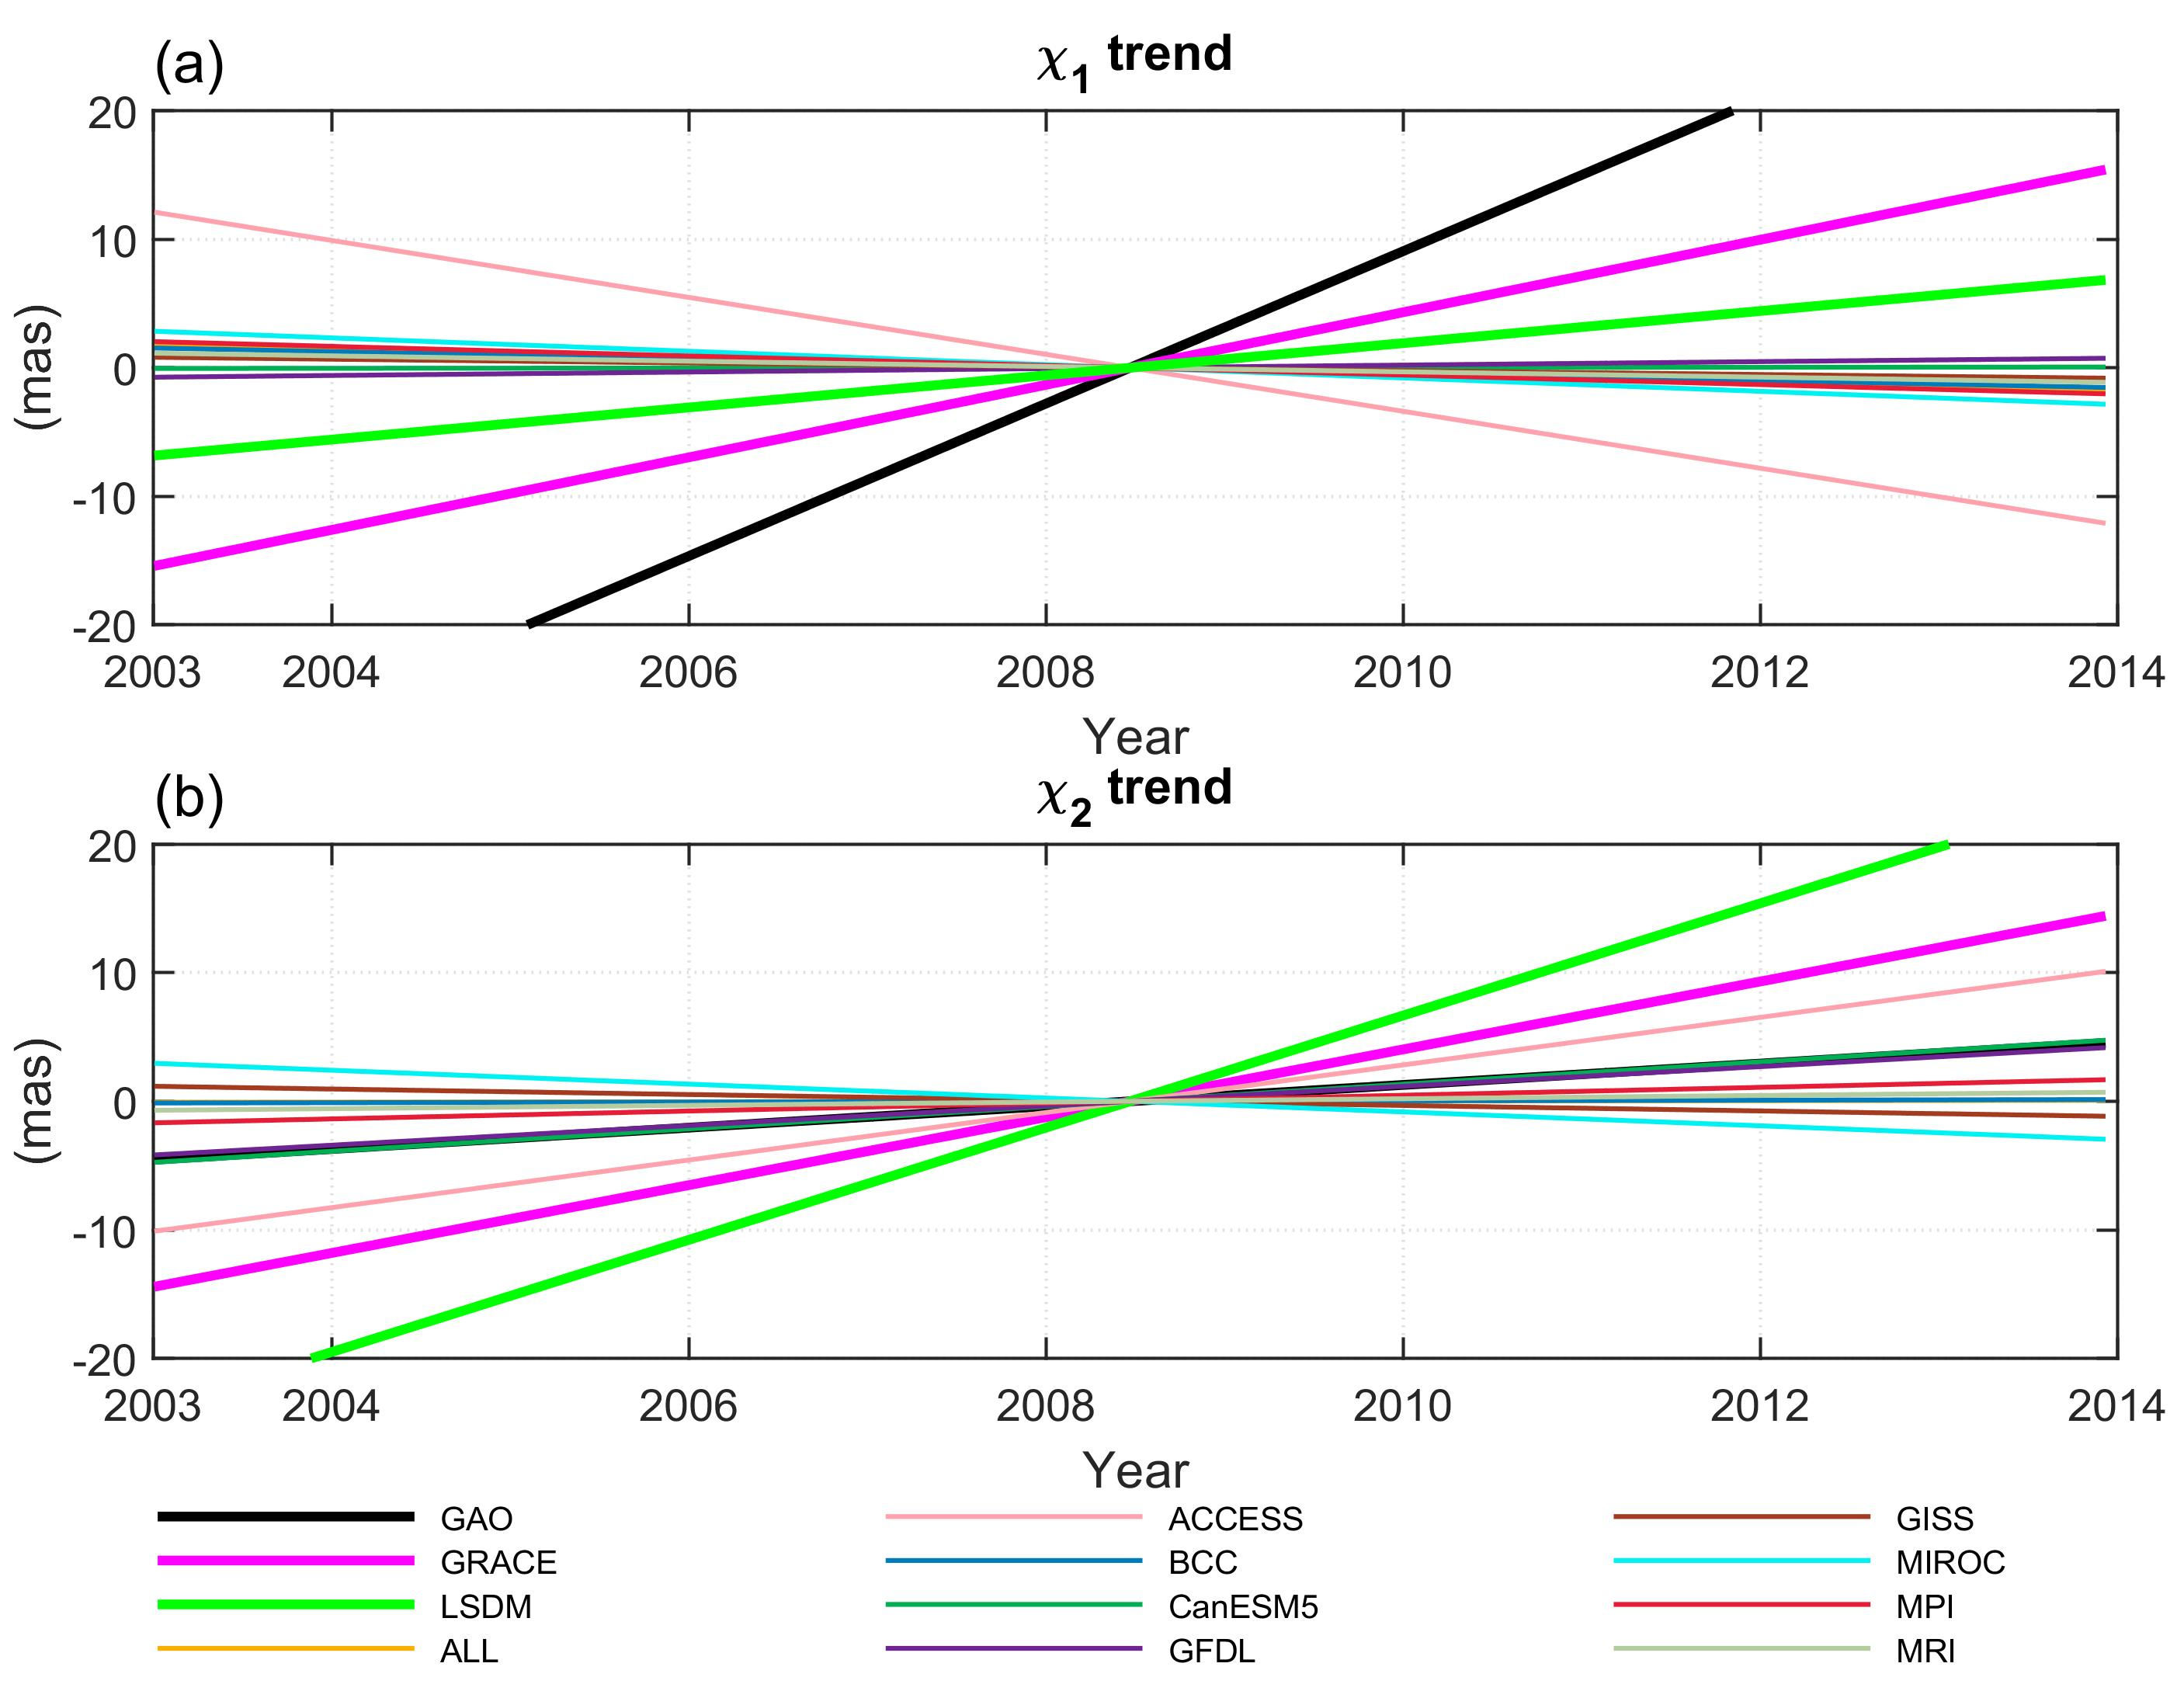
Grouped models – Trend
Fig. 5. Trends in χ₁ and χ₂ components of GAO and HAM computed from GRACE, LSDM and mean series of the grouped CMIP6 models
To select the most appropriate models for HAM determination we looked for a CMIP6 model that provides the smallest trend difference with respect to the GAO

Slide 15
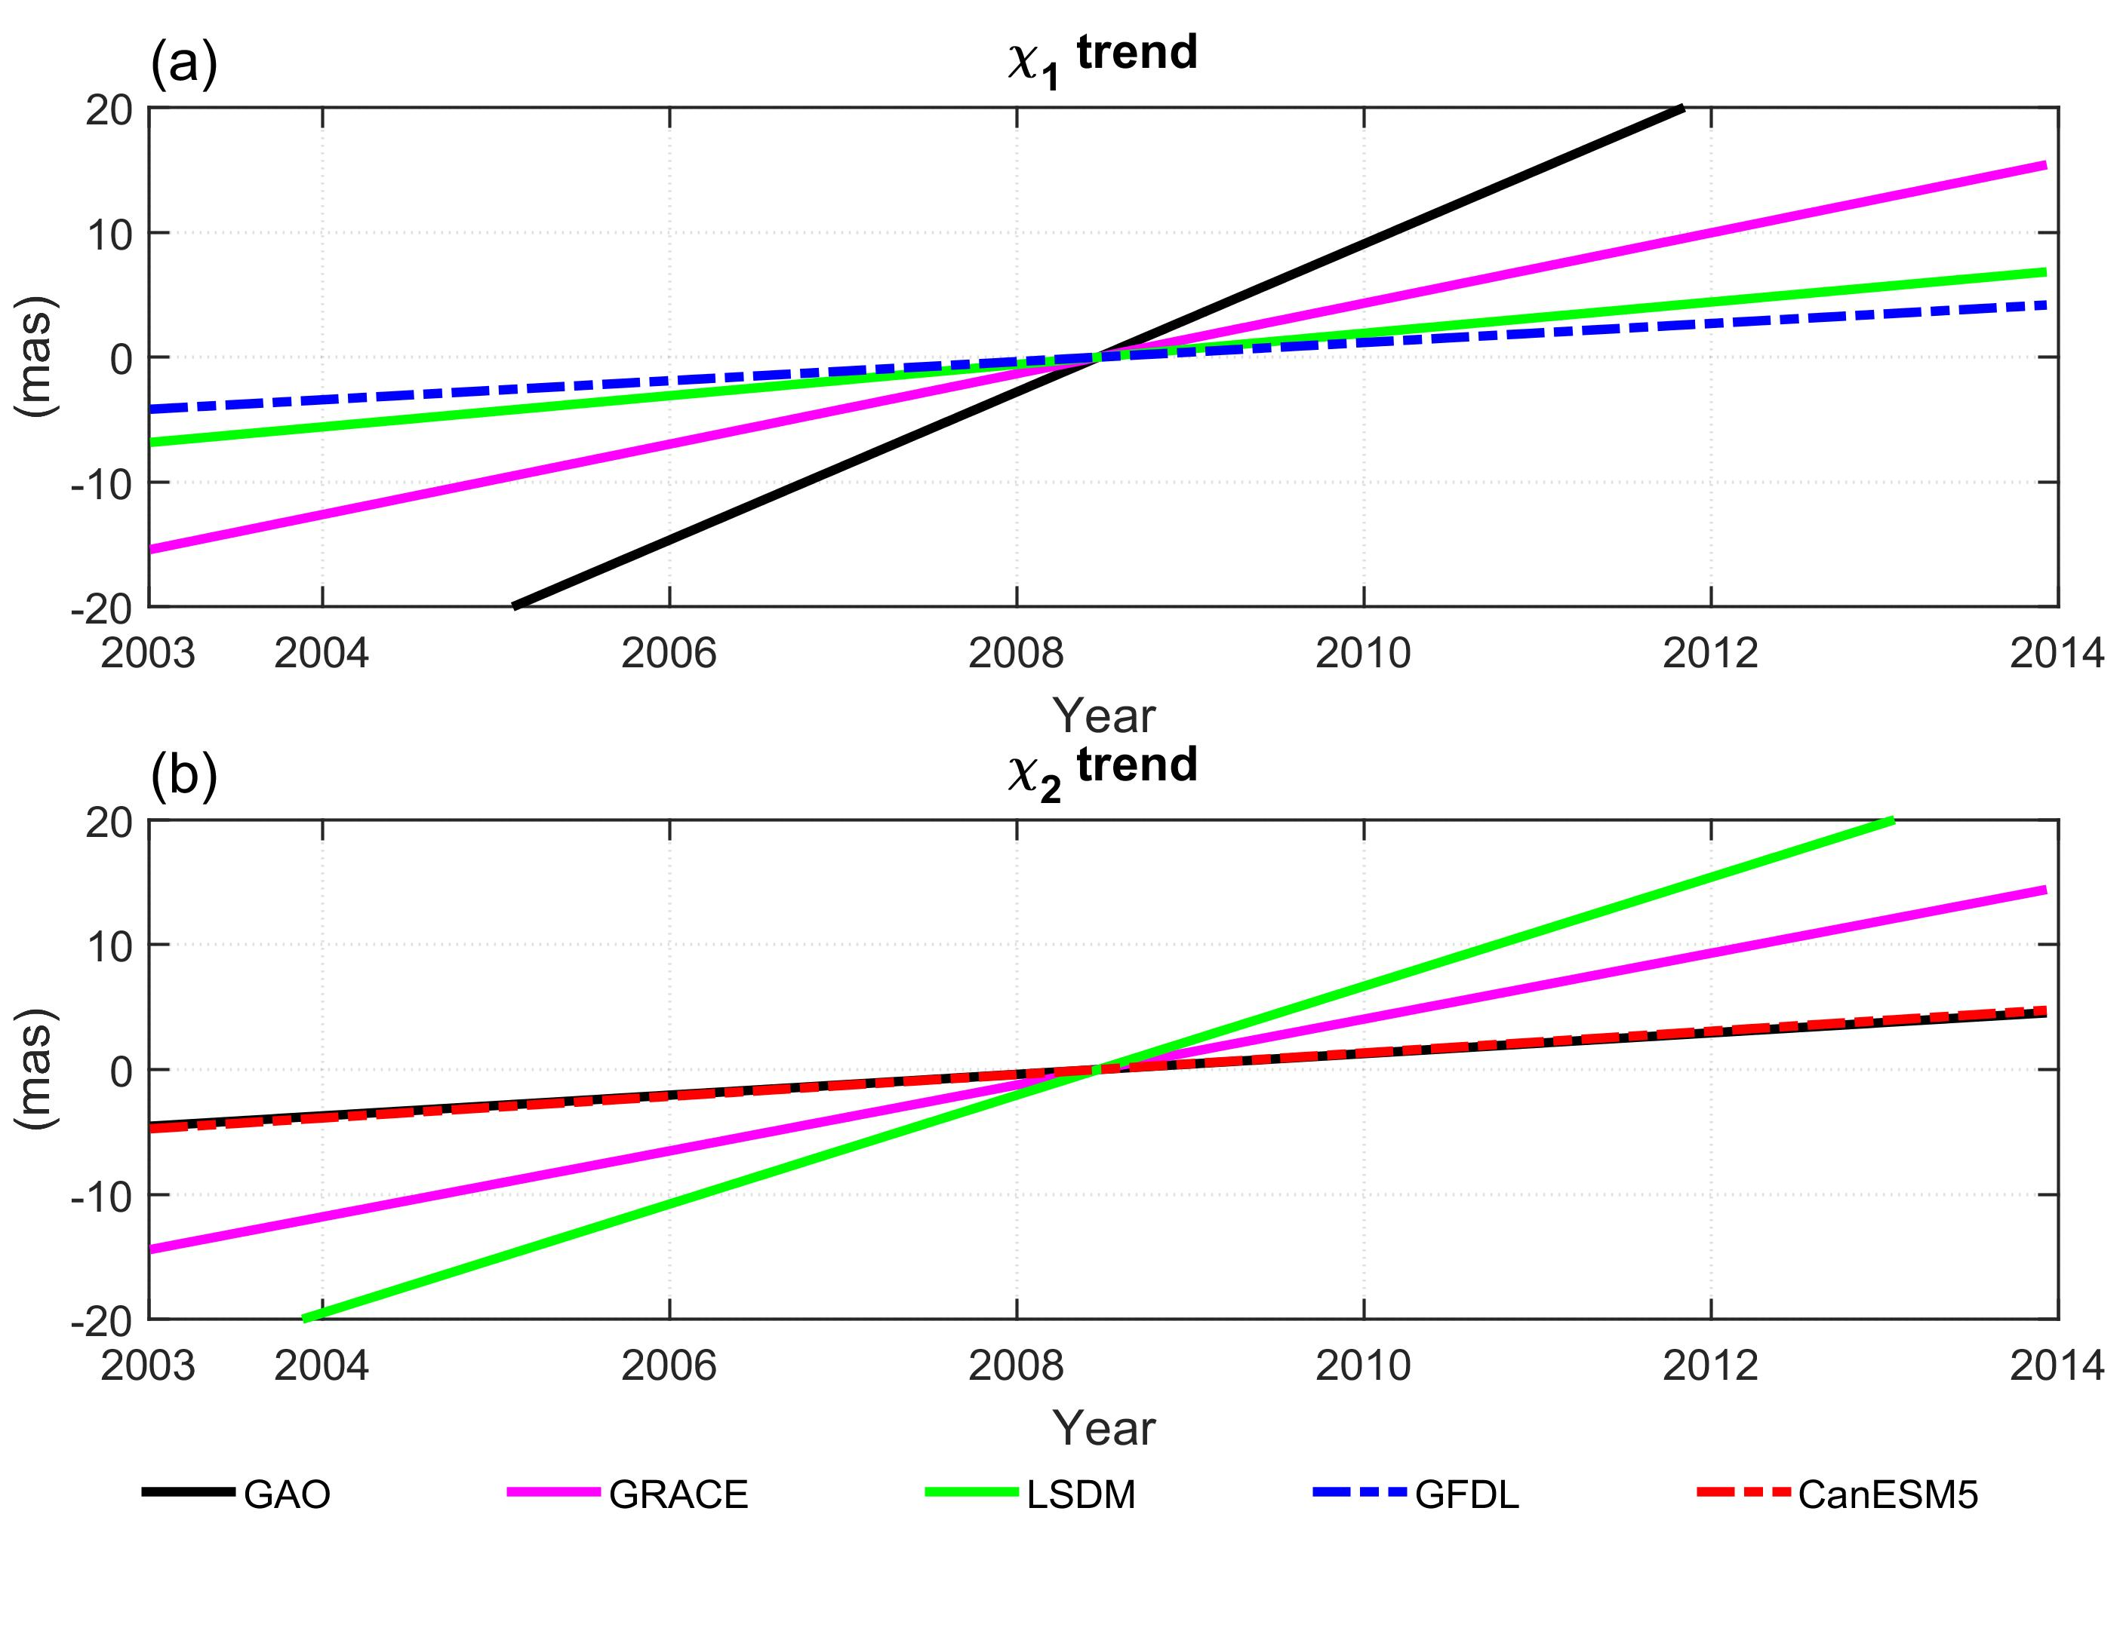
Grouped models – Trend – Best models
Fig. 6. Trends in χ₁ and χ₂ components of GAO and HAM computed from GRACE, LSDM and the best fitted mean of the grouped CMIP6 models
It is not possible to find one model that provides the best agreement between HAM and GAO in terms of both χ₁ and χ₂ component.
Two chosen models (GFDL, CanESM5) provide better consistency between HAM and GAO than GRACE or LSDM.

Slide 16
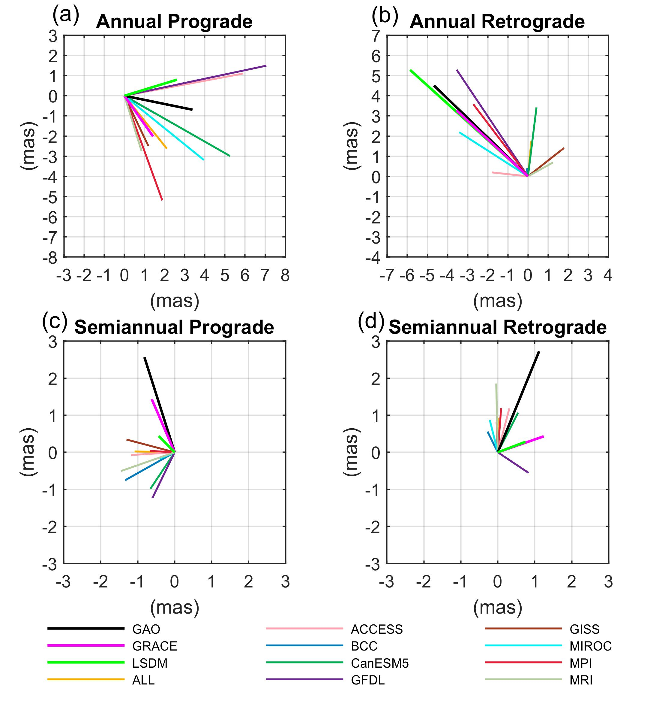
Grouped models – Oscillations
Fig. 7. Phasor diagrams of annual prograde (a) semiannual prograde (b) annual retrograde (c) semiannual retrograde (d) oscillation in geodetic residuals (GAO) and hydrological excitation functions (HAM) computed from: GRACE (CSR), LSDM (GFZ), and averaged series of CMIP6 model groups.
To select the most appropriate models for HAM determination in seasonal spectral band, we looked for a CMIP6 model that provides the smallest difference in either the phase or the amplitude of annual and semiannual oscillation
We calculated the differences in amplitude between GAO and each CMIP6-based HAM, separately for prograde and retrograde term.
We then searched for the minimum value of the absolute difference between amplitudes. We used a similar procedure for the phase differences.

Slide 17
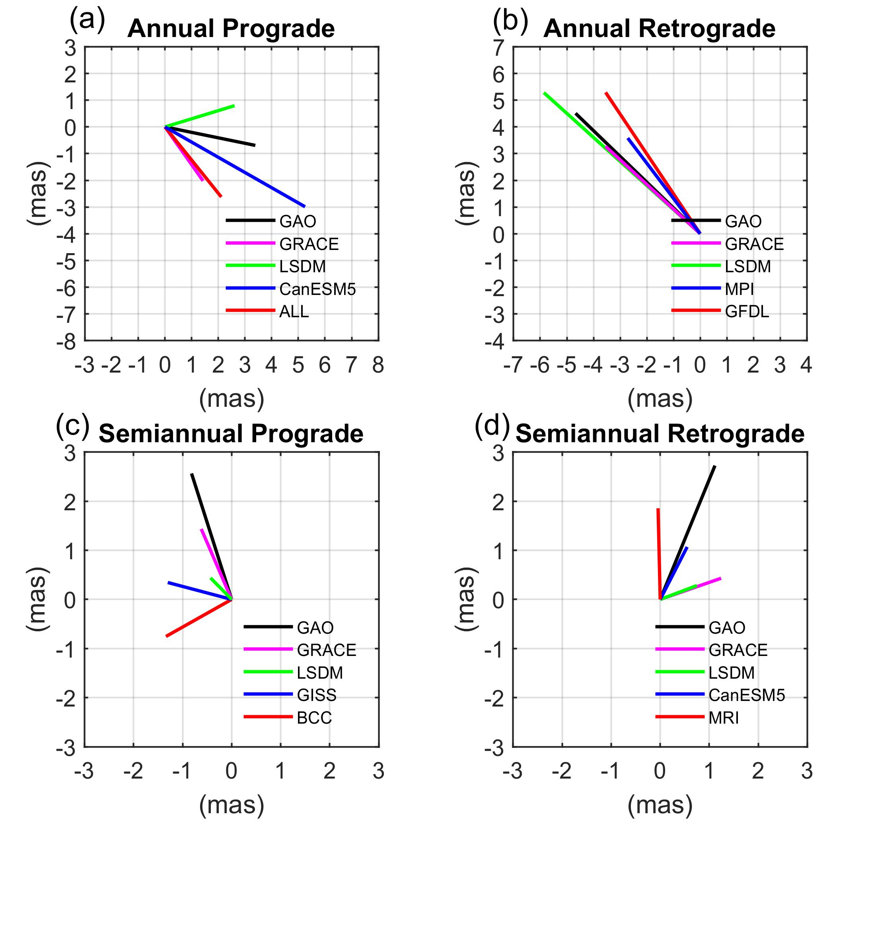
Grouped models – Oscillations – Best models
Fig. 8. Phasor diagrams of (a) annual prograde (b) annual retrograde (c) semiannual retrograde (d) semiannual retrograde oscillation in (GAO) and hydrological excitation functions (HAM) computed from GRACE (CSR-RL06), LSDM (GFZ), and in best fitted models selected from grouped CMIP6. In terms of amplitude agreement (red line) in terms of phase agreement (blue line)
It is not possible to find one model that provides the best agreement between HAM and GAO in terms of both amplitude and phase.
The chosen models are also different for prograde and retrograde terms.
The chosen models provide similar consistency between HAM and GAO than GRACE or LSDM (except the case of phase for semiannual prograde term, for which GRACE provides the best result).

Slide 18
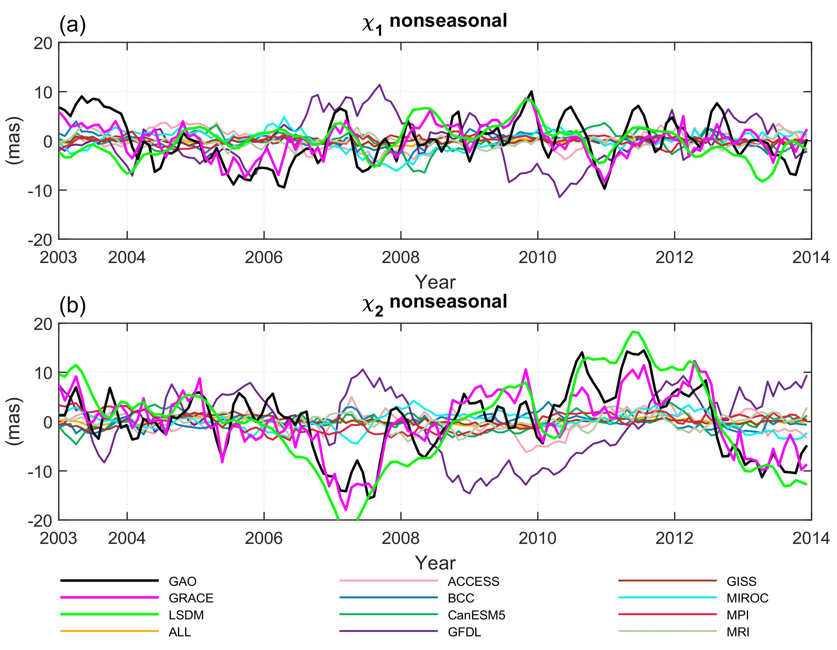
Grouped models – Nonseasonal
Fig. 9. χ₁ and χ₂ components of non-seasonal oscillations in GAO and HAM computed from GRACE, LSDM and grouped CMIP6 models
For nonseasonal oscillation:
We looked for a group model that provides the highest correlation of HAM with GAO and the lowest difference in variance between HAM and GAO.
We calculated the differences in variance of χ₁ and χ₂ components between GAO and each grouped CMIP6-based HAM. We then searched for the minimum value of the absolute difference between variances.
We computed correlation coefficients between GAO and each grouped CMIP6-based HAM for χ₁ and χ₂ components. We then searched for the maximum value.

Slide 19
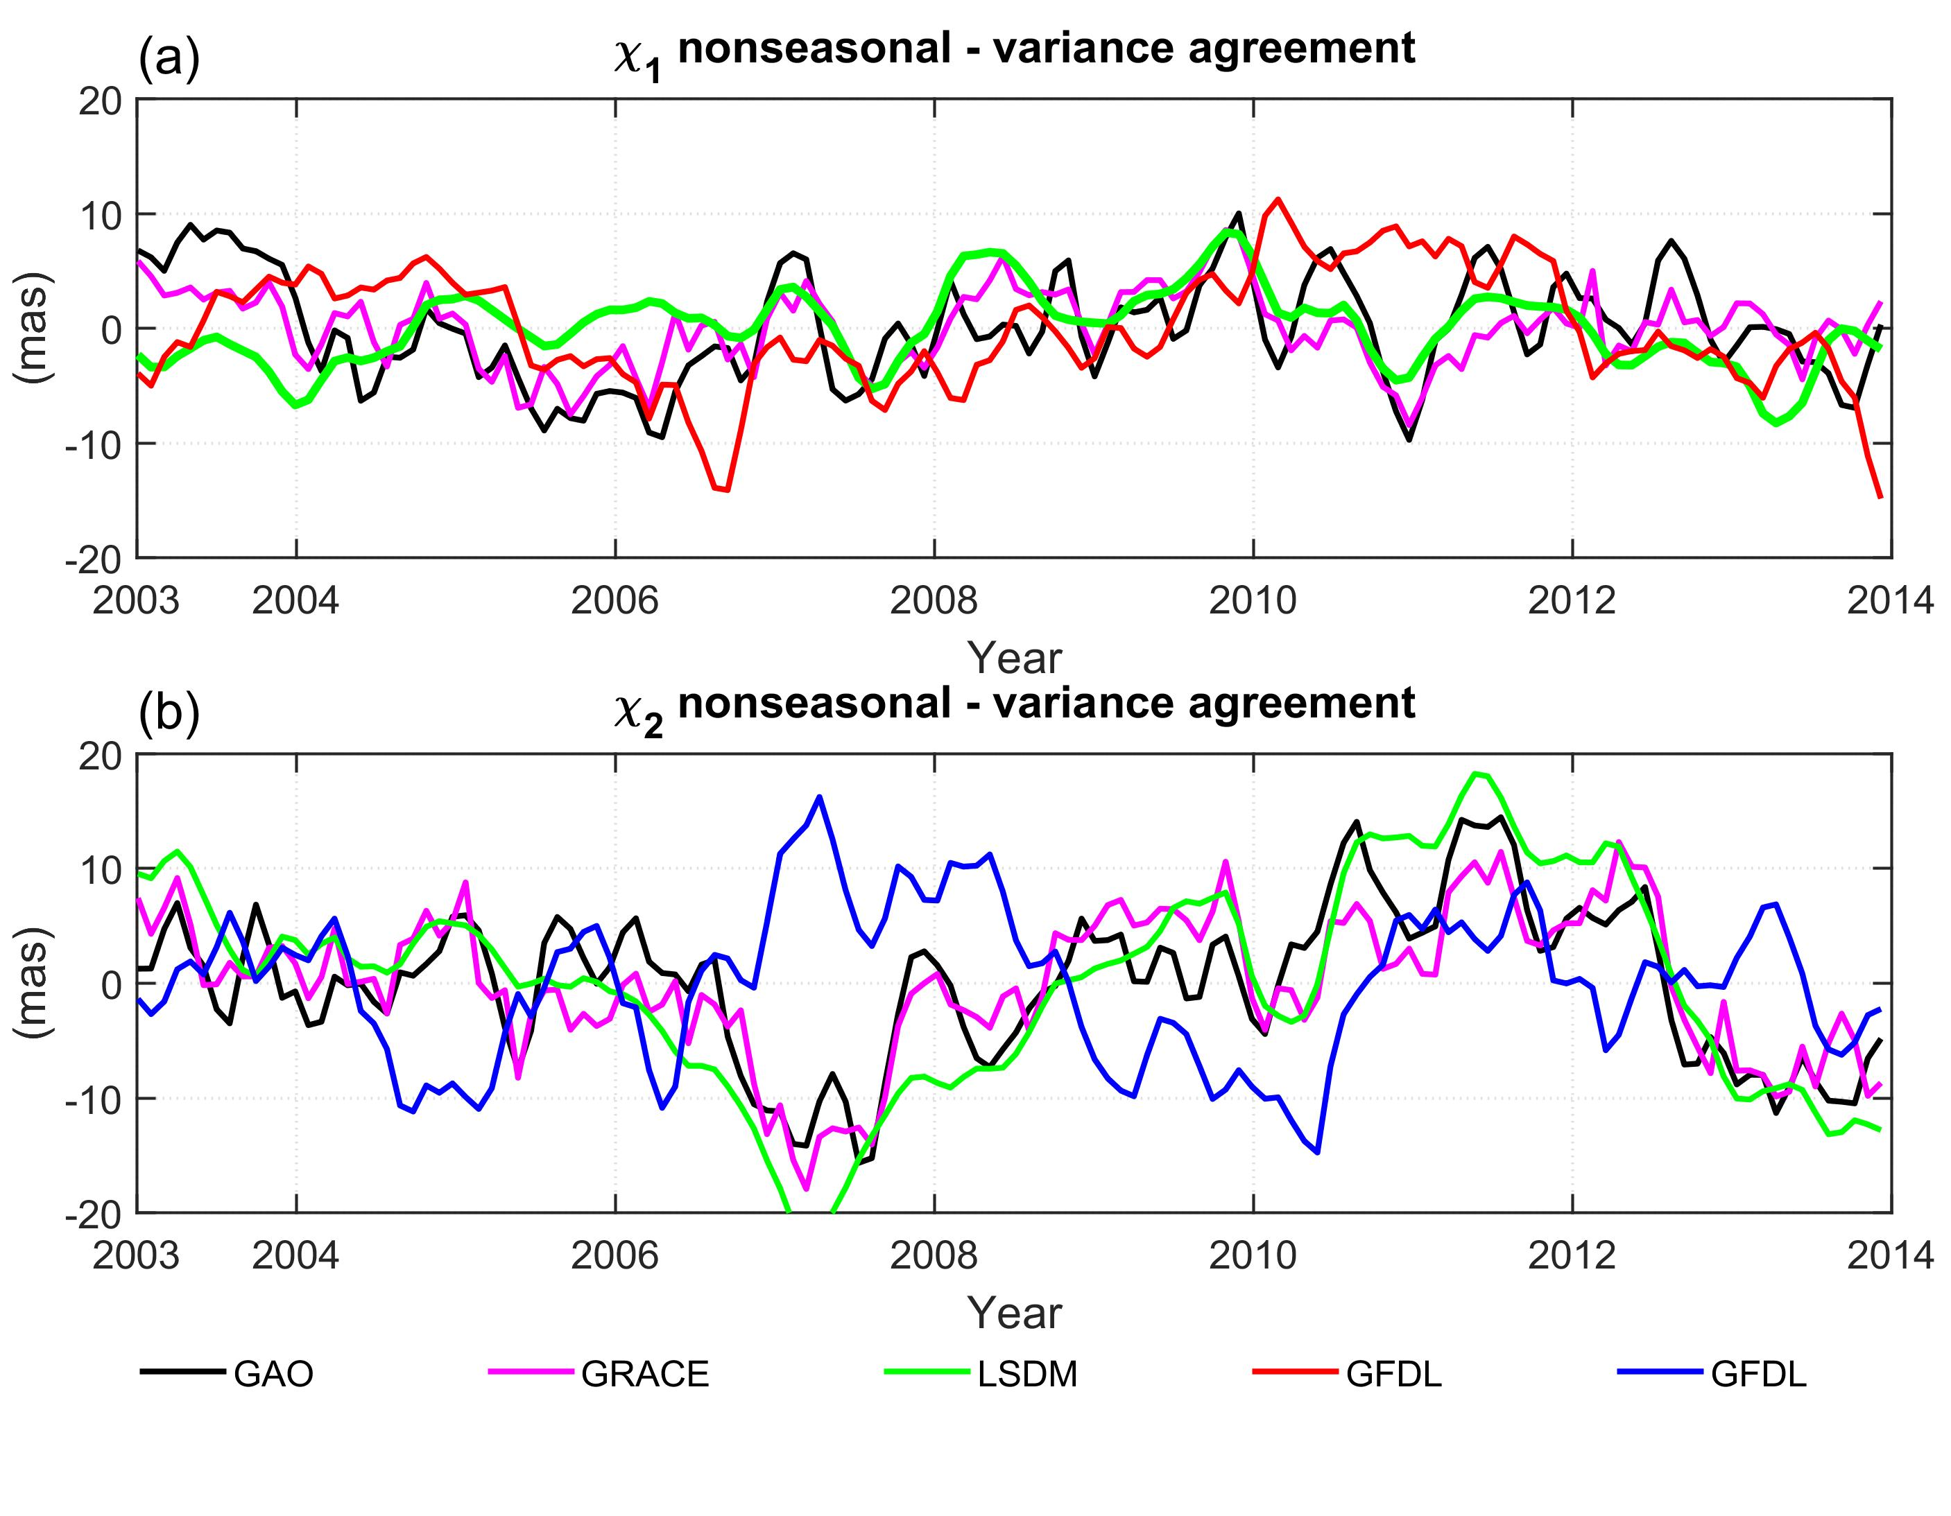
Grouped models – Nonseasonal – Best models
Table 6. Absolute values of differences of non-seasonal variance in χ₁ and χ₂ between GAO and HAM from CMIP6
$χ_{1}$ (mas) |  | $χ_{2}$ (mas)
Model | Difference (mas) | Model | Difference (mas)
GFDL | 0.55 | GFDL | 0.02
GRACE | 10.51 | GRACE | 3.55
LSDM | 10.75 | LSDM | 40.48
GFDL is better fitted to GAO in variance than GRACE and LSDM.
Table 7. Correlation coefficients between GAO and HAM from CMIP6 for χ₁ and χ₂
$χ_{1}$ (mas) |  | $χ_{2}$ (mas)
Model | Correlation | Model | Correlation
BCC | 0.39 | MIROC | 0.49
GRACE | 0.68 | GRACE | 0.84
LSDM | 0.20 | LSDM | 0.84
Fig. 10. χ₁ and χ₂ components of non-seasonal oscillations in GAO and HAM computed from GRACE, LSDM together with best fitted grouped CMIP6 models

Slide 20
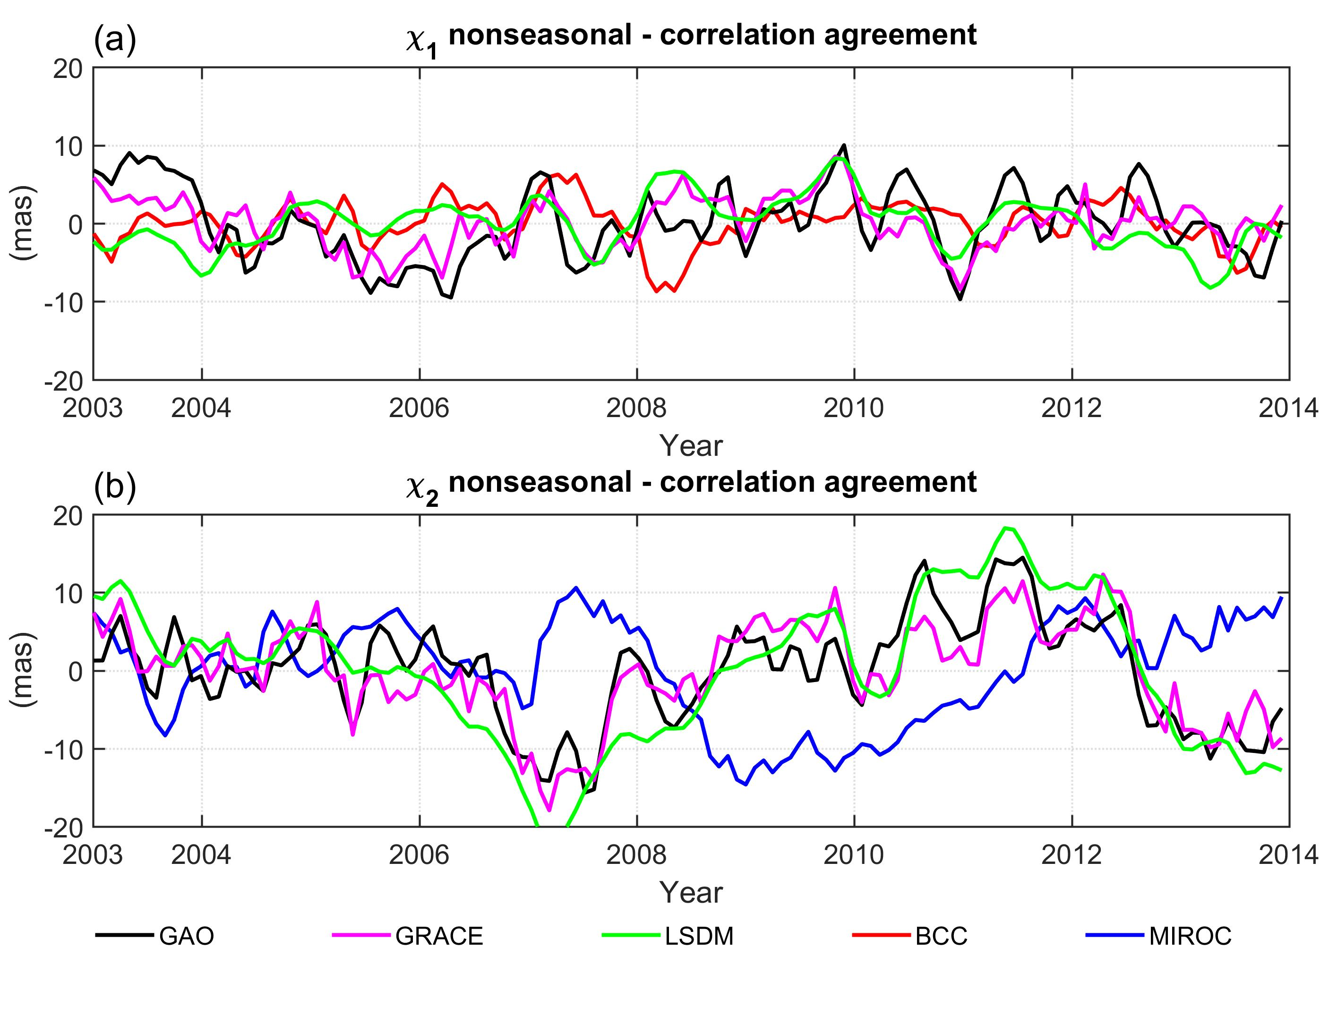
Grouped models – Nonseasonal – Best models
Table 6. Absolute values of differences of non-seasonal variance in χ₁ and χ₂ between GAO and HAM from CMIP6
$χ_{1}$ (mas) |  | $χ_{2}$ (mas)
Model | Difference (mas) | Model | Difference (mas)
GFDL | 0.55 | GFDL | 0.02
GRACE | 10.51 | GRACE | 3.55
LSDM | 10.75 | LSDM | 40.48
Table 7. Correlation coefficients between GAO and HAM from CMIP6 for χ₁ and χ₂
$χ_{1}$ (mas) |  | $χ_{2}$ (mas)
Model | Correlation | Model | Correlation
BCC | 0.39 | MIROC | 0.49
GRACE | 0.68 | GRACE | 0.84
LSDM | 0.20 | LSDM | 0.84
Fig. 11. χ₁ and χ₂ components of non-seasonal oscillations in GAO and HAM computed from GRACE, LSDM together with best fitted grouped CMIP6 models
GRACE series is best correlated with GAO in χ₁ and χ₂.
In χ₂ LDSM has very high correlation with GAO.

Slide 21
Conclusions
Our preliminary analyses have shown that selection of the best CMIP6 model for the study of HAM depends on several factors, such as considered oscillation, analysed equatorial component of HAM or the assumed criterion of validation. Since the large number of simulations in CMIP6 make it difficult to choose the most appropriate fit for GAO, in this work we analysed the averaged series of the models.
The consistency analysis of the models showed that the average series obtained from all 99 models cannot be recommended for comparison with GAO.
For individual climate series the spread of the values is significant. Averaged models grouped by providing institute in overall are characterized by slightly lower range but still meaningful.
Generally, the analyses confirm the results obtained from previous studies. It is possible to find CMIP6 models from among 99 available as well as from grouped CMIP6 series that provides HAM series more compatible with GAO than HAM determined from GRACE or from LSDM, especially in annual oscillations.
Trend: it is not possible to find one model that provides the best agreement between HAM and GAO in terms of both χ₁ and χ₂ component. The chosen grouped models (GFDL, CanESM5) provide better consistency between HAM and GAO than GRACE or LSDM.
Seasonal Oscillation: it is not possible to find one model that provides the best agreement between HAM and GAO in terms of both amplitude and phase. However, the chosen models provide similar consistency between HAM and GAO than GRACE or LSDM (except the case of phase for semiannual prograde term, for which GRACE provides the best result).
Nonseasonal Oscillation: GRACE-based series is best correlated to GAO in χ₁ and χ₂. In χ₂ LDSM has very high correlation with GAO as well.

Slide 22
Thank you

Slide 23
Appendixes

Slide 24
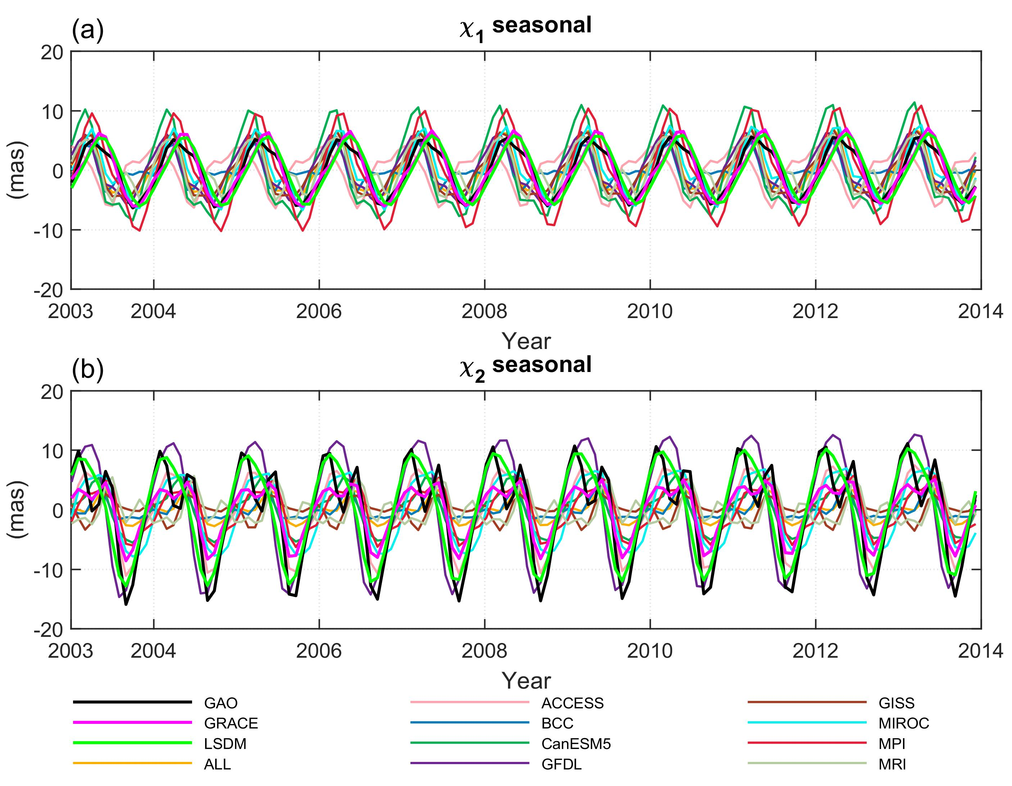
Grouped models – Seasonal Oscillations
Fig. A1. χ₁ and χ₂ components of seasonal oscillations in GAO and HAM computed from GRACE, LSDM and grouped CMIP6 models

Slide 25
Spread of CMIP6-based HAM – statistical summary
Table A1. Statistics in χ₁ and χ₂ components of GAO and HAM computed from CMIP6 models and MEAN model
 |  | CMIP |  |  | GAO |  |  | MEAN
 |  | MIN | Median | MAX | MIN | Median | MAX | MIN | Median | MAX
Seasonal | $χ_{1}$ (mas) | -15.42 | -0.47 | 14.52 | -6.33 | 0.20 | 5.59 | -4.53 | -1.33 | 7.02
 | $χ_{2}$ (mas) | -15.10 | 0.14 | 12.63 | -15.90 | 1.35 | 11.14 | -2.76 | -0.08 | 3.58
Nonseasonal | $χ_{1}$ (mas) | -21.37 | 0.15 | 13.97 | -9.72 | -0.24 | 10.01 | -1.23 | 0.09 | 1.30
 | $χ_{2}$ (mas) | -23.09 | 0.04 | 23.56 | -15.64 | 0.88 | 14.46 | -1.19 | -0.08 | 1.32
 | Trend
 | CMIP |  |  | GAO | MEAN
 | MIN | Median | MAX
$χ_{1}$ (mas) | -5.35 | -0.23 | 1.31 | 5.93 | -0.33
$χ_{2}$ (mas) | -1.74 | 0.00 | 4.22 | 0.83 | 0.01
Table A2. Statistics of oscillations in GAO and HAM computed from CMIP6 models and MEAN model
 |  | CMIP |  |  | GAO | MEAN
 |  | MIN | Median | MAX
Annual Prograde | $Phase$ (°) | -32.84 | 0.00 | 0.00 | -11.56 | -51.18
 | Amplitude (mas) | 1.38 | 3.30 | 7.67 | 3.46 | 3.37
Annual Retrograde | $Phase$ (°) | 0.00 | 0.00 | 100.90 | 136.03 | 84.57
 | Amplitude (mas) | 0.29 | 3.01 | 7.08 | 6.50 | 1.75
Semiannual Prograde | $Phase$ (°) | -151.99 | 0.00 | 0.00 | 107.69 | 178.80
 | Amplitude (mas) | 0.05 | 1.27 | 2.22 | 2.69 | 1.08
Semiannual Prograde | $Phase$ (°) | 0.00 | 0.00 | 106.45 | 67.72 | 89.98
 | Amplitude (mas) | 0.02 | 0.98 | 2.25 | 2.94 | 0.93

Slide 26
Table A3. Absolute values of differences in amplitude of annual prograde and annual retrograde oscillation between GAO and HAM from CMIP6
Table A4. Absolute values of differences in phase of annual prograde and annual retrograde oscillation between GAO and HAM from CMIP6
Annual prograde amplitude |  | Annual retrograde amplitude
Model | Difference (mas) | Model | Difference (mas)
ALL | 0.09 | GFDL | 0.13
MRI | 0.58 | MPI | 2.00
GISS | 0.69 | MIROC | 2.44
MIROC | 1.62 | CanESM5 | 3.05
BCC | 1.74 | GISS | 4.22
MPI | 2.06 | ACCESS | 4.70
ACCESS | 2.56 | ALL | 4.75
CanESM5 | 2.59 | MRI | 5.07
GFDL | 3.76 | BCC | 6.09
GRACE | 0.98 | GRACE | 1.66
LSDM | 0.73 | LSDM | 1.40
Annual prograde phase |  | Annual retrograde phase
Model | Difference (degrees) | Model | Difference (degrees)
CanESM5 | 18.10 | MPI | 8.85
BCC | 18.28 | MIROC | 11.34
ACCESS | 22.12 | GFDL | 12.20
GFDL | 23.5 | ACCESS | 37.71
MIROC | 27.33 | BCC | 38.40
ALL | 39.63 | ALL | 51.47
GISS | 52.89 | CanESM5 | 53.09
MPI | 58.49 | GISS | 97.91
MRI | 61.20 | MRI | 107.10
GRACE | 43.20 | GRACE | 1.32
LSDM | 28.51 | LSDM | 1.95
Table A5. Absolute values of differences in amplitude of semiannual prograde and semiannual retrograde oscillation between GAO and HAM from CMIP6
Table A6. Absolute values of differences in phase of semiannual prograde and semiannual retrograde oscillation between GAO and HAM from CMIP6
Semiannual prograde amplitude |  | Semiannual retrograde amplitude
Model | Difference (mas) | Model | Difference (mas)
BCC | 1.15 | MRI | 1.09
MRI | 1.16 | ACCESS | 1.72
GFDL | 1.31 | CanESM5 | 1.74
GISS | 1.34 | MPI | 1.75
ACCESS | 1.50 | GFDL | 1.95
CanESM5 | 1.51 | ALL | 2.01
ALL | 1.61 | MIROC | 2.05
MPI | 2.02 | GISS | 2.13
MIROC | 2.25 | BCC | 2.32
GRACE | 1.13 | GRACE | 1.63
LSDM | 2.08 | LSDM | 2.14
Semiannual prograde phase |  | Semiannual retrograde phase
Model | Difference (degrees) | Model | Difference (degrees)
GISS | 57.49 | CanESM5 | 4.91
MPI | 69.00 | ACCESS | 7.53
ALL | 71.10 | MPI | 17.96
GFDL | 223.72 | ALL | 22.26
CanESM5 | 231.38 | MRI | 23.62
BCC | 258.32 | GISS | 24.52
MIROC | 264.86 | MIROC | 36.26
MRI | 268.50 | BCC | 48.74
ACCESS | 284.13 | GFDL | 101.45
GRACE | 5.68 | GRACE | 48.58
LSDM | 26.84 | LSDM | 47.06

Slide 27
Table A7. Absolute values of differences of nonseasonal variance in χ₁ and χ₂ between GAO and HAM from CMIP6
Table A8. Correlation coefficients between GAO and HAM from CMIP6 for χ₁ and χ₂
$χ_{1}$ (mas) |  | $χ_{2}$ (mas)
Model | Difference (mas) | Model | Difference (mas)
GFDL | 0.55 | GFDL | 0.02
MIROC | 17.58 | ACCESS | 39.01
ACCESS | 17.97 | MPI | 39.8
CanESM5 | 18.55 | MIROC | 39.82
BCC | 20.17 | CanESM5 | 40.55
MRI | 20.29 | MRI | 41.05
MPI | 20.88 | BCC | 41.83
GISS | 21.39 | GISS | 42.68
ALL | 21.43 | ALL | 43.01
GRACE | 10.51 | GRACE | 3.55
LSDM | 10.75 | LSDM | 40.48
$χ_{1}$ (mas) |  | $χ_{2}$ (mas)
Model | Correlation | Model | Correlation
ACCESS | -0.21 | GFDL | -0.28
MIROC | -0.13 | MRI | -0.16
GFDL | -0.09 | BCC | -0.05
MPI | -0.07 | CanESM5 | 0.05
CanESM5 | 0.04 | GISS | 0.07
ALL | 0.06 | ACCESS | 0.10
MRI | 0.17 | MPI | 0.23
GISS | 0.19 | ALL | 0.30
BCC | 0.39 | MIROC | 0.49
GRACE | 0.68 | GRACE | 0.84
LSDM | 0.20 | LSDM | 0.84

Slide 28
Grouped models – Trend
Table A9. Absolute values of trend differences in χ₁ and χ₂ between GAO and HAM from CMIP6
$χ_{1}$ (mas) |  | $χ_{2}$ (mas)
Model | Difference (mas/year) | Model | Difference (mas/year)
GFDL | 5.79 | CanESM5 | 0.04
CanESM5 | 5.92 | GFDL | 0.07
GISS | 6.08 | MPI | 0.52
MRI | 6.14 | MRI | 0.70
BCC | 6.21 | BCC | 0.81
ALL | 6.26 | ALL | 0.82
MPI | 6.30 | ACCESS | 1.02
MIROC | 6.45 | GISS | 1.04
ACCESS | 8.14 | MIROC | 1.37
GRACE | 3.11 | GRACE | 1.81
LSDM | 4.68 | LSDM | 3.53
We looked for a CMIP6 model that provides the smallest difference in either amplitude or phase of the annual vector compared to the GAO vector.
Fig. A2. Trends in χ₁ and χ₂ components of GAO and HAM computed from GRACE, LSDM and mean of the grouped CMIP6 models

Slide 29
Grouped models – Nonseasonal
Table A10. Absolute values of differences of non-seasonal variance in χ₁ and χ₂ between GAO and HAM from CMIP6
$χ_{1}$ (mas) |  | $χ_{1}$ (mas)
Model | Difference (mas) | Model | Difference (mas)
GFDL | 0.55 | GFDL | 0.02
MIROC | 17.58 | ACCESS | 39.01
ACCESS | 17.97 | MPI | 39.8
CanESM5 | 18.55 | MIROC | 39.82
BCC | 20.17 | CanESM5 | 40.55
MRI | 20.29 | MRI | 41.05
MPI | 20.88 | BCC | 41.83
GISS | 21.39 | GISS | 42.68
ALL | 21.43 | ALL | 43.01
GRACE | 10.51 | GRACE | 3.55
LSDM | 10.75 | LSDM | 40.48
Table A11. Correlation coefficients between GAO and HAM from CMIP6 for χ₁ and χ₂
$χ_{1}$ (mas) |  | $χ_{1}$ (mas)
Model | Correlation | Model | Correlation
ACCESS | -0.21 | GFDL | -0.28
MIROC | -0.13 | MRI | -0.16
GFDL | -0.09 | BCC | -0.05
MPI | -0.07 | CanESM5 | 0.05
CanESM5 | 0.04 | GISS | 0.07
ALL | 0.06 | ACCESS | 0.10
MRI | 0.17 | MPI | 0.23
GISS | 0.19 | ALL | 0.30
BCC | 0.39 | MIROC | 0.49
GRACE | 0.68 | GRACE | 0.84
LSDM | 0.20 | LSDM | 0.84
Fig. A3. χ₁ and χ₂ components of nonseasonal oscillations in GAO and HAM computed from GRACE, LSDM together with best CMIP6 models

Slide 30
Grouped models – Nonseasonal
Table A10. Absolute values of differences of non-seasonal variance in χ₁ and χ₂ between GAO and HAM from CMIP6
$χ_{1}$ (mas) |  | $χ_{1}$ (mas)
Model | Difference (mas) | Model | Difference (mas)
GFDL | 0.55 | GFDL | 0.02
MIROC | 17.58 | ACCESS | 39.01
ACCESS | 17.97 | MPI | 39.8
CanESM5 | 18.55 | MIROC | 39.82
BCC | 20.17 | CanESM5 | 40.55
MRI | 20.29 | MRI | 41.05
MPI | 20.88 | BCC | 41.83
GISS | 21.39 | GISS | 42.68
ALL | 21.43 | ALL | 43.01
GRACE | 10.51 | GRACE | 3.55
LSDM | 10.75 | LSDM | 40.48
Table A11. Correlation coefficients between GAO and HAM from CMIP6 for χ₁ and χ₂
$χ_{1}$ (mas) |  | $χ_{1}$ (mas)
Model | Correlation | Model | Correlation
ACCESS | -0.21 | GFDL | -0.28
MIROC | -0.13 | MRI | -0.16
GFDL | -0.09 | BCC | -0.05
MPI | -0.07 | CanESM5 | 0.05
CanESM5 | 0.04 | GISS | 0.07
ALL | 0.06 | ACCESS | 0.10
MRI | 0.17 | MPI | 0.23
GISS | 0.19 | ALL | 0.30
BCC | 0.39 | MIROC | 0.49
GRACE | 0.68 | GRACE | 0.84
LSDM | 0.20 | LSDM | 0.84
Fig. A4. χ₁ and χ₂ components of non-seasonal oscillations in GAO and HAM computed from GRACE, LSDM together with best CMIP6 models

