Slide 1
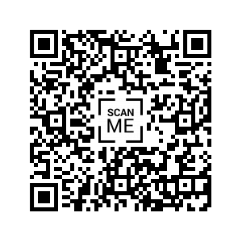
Junior Member Category
Calling all early career astronomers!
If you are within 6 years of obtaining your PhD, be you research or industry bound, this is your opportunity to get a foot in the door to the IAU!
Goals include
Build a network of early career researchers (ECRs) and enable active involvement in the IAU, its commissions, and other mechanisms
Identify issues of ECRs and propose measures to resolve them and improve the research environment and working conditions
Organise conferences to exchange experiences, promote research, industry involvement, and entrepreneurship aimed at transcending the research-market boundary
Apply to become a junior member today! Give your ideas and help shape the future!
More information at: https://www.iau.org/science/scientific_bodies/working_groups/310/juniormembers/

